Slide 1
Type Casting
CS 201, Summer 2013

Slide 2
ADDITIONAL READING
Casting Variables
  Chapter 15 of Pearson book
  http://www.cplusplus.com/doc/tutorial/typecasting/

Slide 3
Casting Variables
Sometimes, you may want to cast a variable from one data-type to another data-type.
  Storing dollars and cents as two separate integers, but wanting to combine them into a float.
  Casting numbers to strings and vice versa
  Casting a base class pointer to a descendant so we can use the specialized functions

Slide 4


Basic Casting
C-Style Casting:
C++-Style Casting:
Function

Slide 5
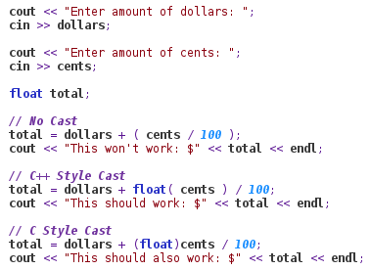
Basic Casting
If we want to divide an int and keep the remainder, we need to first cast the integer to a float before we divide.
If we don't cast the integer to a float, then any remainder will get thrown out.
(NOT rounded!)

Slide 6

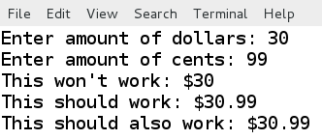


Basic Casting
If we just tried to divide an integer (cents) by 100, even if we were storing the result as a float, it would still first cast the result to an integer before storing it.

Slide 7
Ints to Strings
This is just F.Y.I., not part of our assignments unless you choose to add it.
There is no “Int to String” cast function in C++, so we have to take care of this ourself.
There is an “itoa” (int to string) and “atoi” (string to int) function, but they're not standard.

Slide 8
Ints to Strings
To convert an Integer to a String, we need to utilize String Streams.
These are similar to our console I/O streams and file I/O streams.

Slide 9
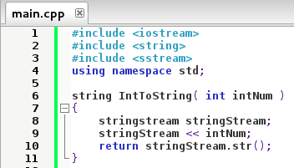
Int to String
Need to include <sstream> library
Creating a stringstream and outputting our integer into it.
Casting the stringstream back to a string

Slide 10
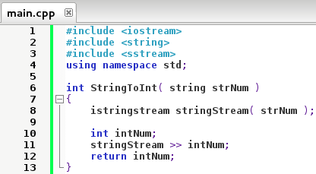
String to Int
Creating an “istringstream” and initializing it as our string
Streaming the contents of our istringstream into an integer

Slide 11
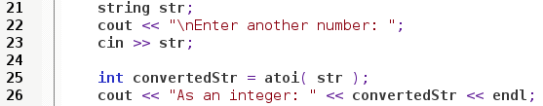
Non-standard atoi (String to Int)
atoi works with a string and returns an int value

Slide 12
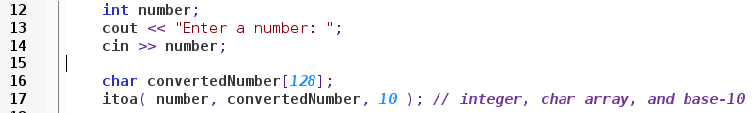
Non-standard itoa (Int to String)
With itoa:
  The first parameter is an integer,
  The second parameter is a char array
  The last parameter is the number base (eg base 10, base 2, base 16).

Slide 13
Casting between Classes
Using C or C++ style casts will not work properly if you're trying to cast between classes.
For example, if you have a pointer to base-class Button* which is pointing to a ImageButton, and want to use a special function only in the ImageButton class, you would need to use a special cast on that pointer.

Slide 14
Type Casting
Dynamic Cast
Static Cast
Reinterpret Cast
Const Cast
Type ID

Slide 15
Dynamic Cast
Can use Dynamic Cast to convert pointers and references.
You can cast a Derived Class to its Base Class
You can only cast a Base Class pointer to a Derived class only if the pointer is pointing to a Derived class.
Derived Class
Base*
Base*
Derived*
Casting OK

Slide 16
Dynamic Cast
Your Dynamic Cast will check to make sure the cast is valid.
If you make an invalid cast between classes, it will result in a NULL (which is checkable!)
Cplusplus.com

Slide 17
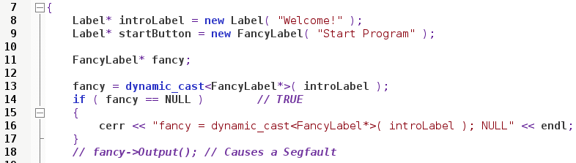
Dynamic Cast
Here, FancyLabel inherits from Label.
IntroLabel is a Label-type variable. We're trying to cast it to a FancyLabel, which will result in our pointer being null.

Slide 18
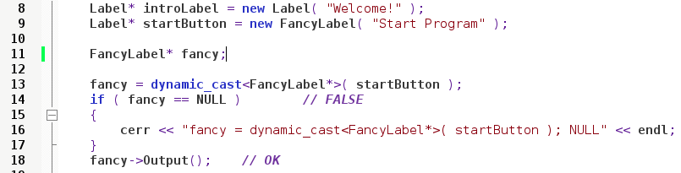
Dynamic Cast
Here, FancyLabel inherits from Label.
startButton is a FancyLable, so we can successfully cast it to a FancyLabel pointer.

Slide 19
Dynamic Cast
Notice that both introLabel and startButton are being declared with Label*.
However, since startButton was created as a new FancyLabel, we can successfully point to it using a FancyLabel* pointer.

Slide 20
Static Cast
Static Cast doesn't have the overhead of Dynamic Cast, but also doesn't have the safety check that Dynamic Cast has.
We must make sure that the conversion is safe
Can cast a Base class to a Child class type
Cplusplus.com

Slide 21
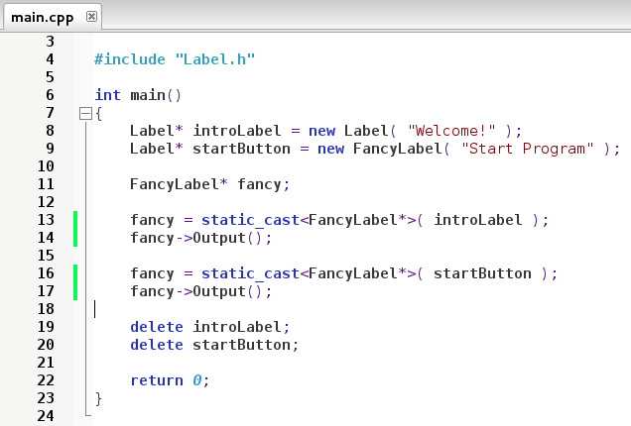
Static Cast
This returned a NULL with a dynamic_cast

Slide 22
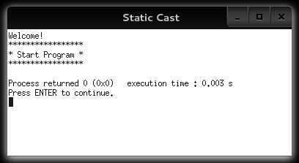
Static Cast
Able to use this pointer with a static_cast.

Slide 23
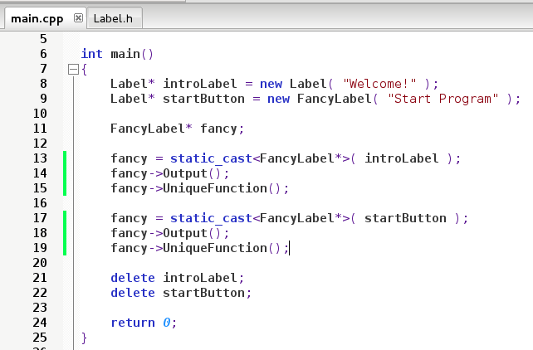
Static Cast
Can even call member functions unique to the Child class, BUT we have to make sure it is valid logic!
If this uses members in the Child but not the Base, we could have uninitialized variables, and UNDEFINED BEHAVIOR

Slide 24
Reinterpret Cast
Can be used to cast between completely unrelated classes! (Will cause undefined behavior if you're not careful!)
Binary copy from one location to another
Cplusplus.com

Slide 25
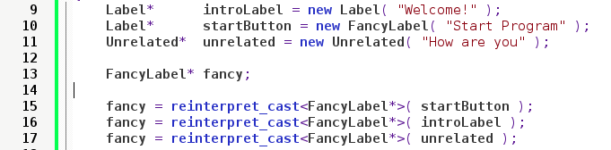
Reinterpret Cast
Casting two unrelated classes is allowed, but you could get undefined behavior

Slide 26
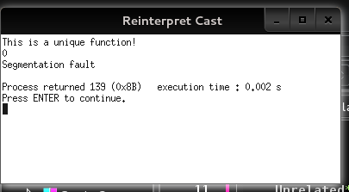
Reinterpret Cast
Here, calling a member function that didn't exist in the Unrelated class caused a segfault.

Slide 27
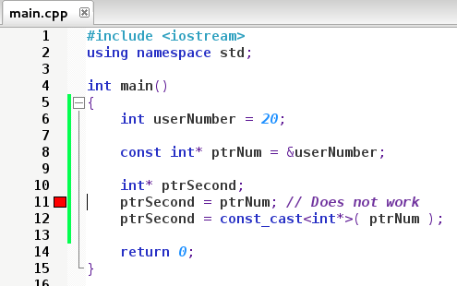
Const Cast
Const Cast is used to add or remove const from an argument.
Cplusplus.com

Slide 28
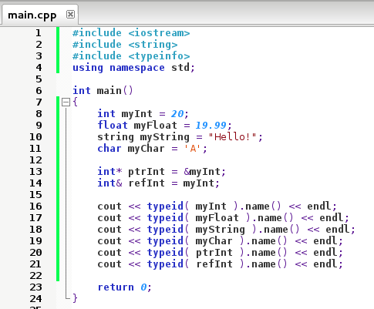
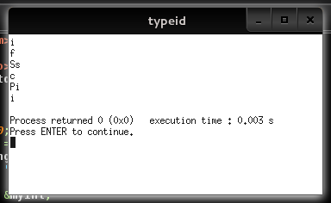
Type ID
Just as something fun, you can have C++ output the type of a variable with “typeid”.
Different compilers may output different values.
Cplusplus.com

Slide 29
Review
Work with a group and turn in on a sheet of paper
Write a base class “Name” which stores a public string for “firstName”. Add a virtual function “Output” which displays the name.
Write a child class inheriting from “Name” called “FullName”. Add a public string for “lastName”. Add a virtual function “Output” which displays the last name, a comma, then the first name.
In main(), declare an instantiation of the FullName class (normal variable).
Create a pointer “ptrName”, which is a Name* pointer. Point it to your FullName instance's address.
Create a pointer “ptrFullName” which is a FullName* pointer. Assign it to the ptrName, but use a dynamic cast to convert ptrName into a FullName*.

Slide 30
References
Type Casting
Cplusplus.com
http://www.cplusplus.com/doc/tutorial/typecasting/

